Slide 2
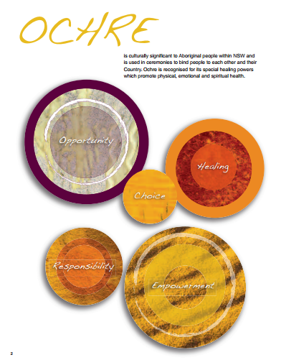

Slide 3
The Hon. Victor Dominello MP Minister for Aboriginal Affairs
Artist Recognition
Kim Healey is a descendant of the Bundjalung and Gumbaynggirr nations.

Slide 4
OCHRE emphasises:
Partnerships over paternalism
Opportunity over disadvantage
Successes over shortfalls
‘Listening to’ over ‘talking at’
Local solutions over ‘one size fits all’
Evidence over assumptions
Participation over marginalisation
Practice over theory
…… and recognises the importance of Healing.
OCHRE aims:
To support strong Aboriginal communities in which Aboriginal people actively influence and fully participate in social, economic and cultural life, we need to:
Teach more Aboriginal languages and culture to build people's pride and identity
Support more Aboriginal students to stay at school
Support more Aboriginal young people to get fulfilling and sustainable jobs
Grow local Aboriginal leaders’ and communities capacity to drive their own solutions
Focus on creating opportunities for economic empowerment
Make both Government and communities more accountable for the money they spend

Slide 5
Identity

Slide 6
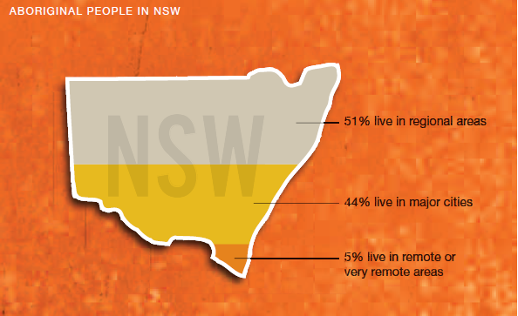
Aboriginal People in NSW

Slide 7
The Aboriginal population in NSW is larger than in any other state . Current as from the 2011 Census stand at 208,364
With a median age of 21 compared to 38 for the non-Aboriginal population.
Aboriginal people make up a higher proportion of Australia’s children and young people and a lower proportion of the elderly.

Slide 8
Major Initiatives
5.1 Linking Education and Employment
5.2 Language
and
Culture
5.4 Accountability
5.3 Local Decision Making
The Taskforce deliberately focused on only three Terms of Reference: Education, Employment and Service delivery.

Slide 9
5.1 Linking Education and Employment

Slide 10
What the evidence is telling us
the key factor in increasing engagement, achievement and school completion is school culture.
Positive aspects of the culture include:
A shared vision for the school community
High expectations of success for both staff and students
A learning environment that is responsive to individual needs
A drive for continuous improvement
Involvement of the Aboriginal community in planning and providing education.
On average a student who completes Yr 12 will earn half a million dollars more over the course of their life than one who left at year 10.

Slide 11
What are we doing?
Connected Communities
Opportunity Hubs
Economic Participation

Slide 12
Connected Communities
The Taskforce endorsed connected Communities which is being implemented by the DEC in 15 schools to improve Aboriginal student educational outcomes.
Connected Communities complements and builds on a number of key reforms in education including:
Local Schools Local Decisions
Early Action for Success
Every Student Every School
Key features will include:
Cultural awareness delivered by locally for all staff
Teaching Aboriginal language and culture
Additional school executive positions
Early-years focus through to further learning and employment
Personalised learning plans for all students
Schools as a hub for service delivery, such as health and community services
Targeted student support and mentoring
Partnership and co-leadership with Aboriginal Community
Partnership with universities and TAFE institutes

Slide 13
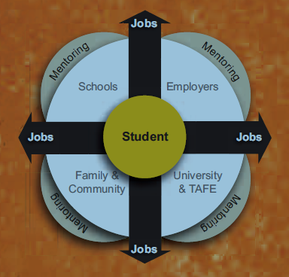
Opportunity Hubs
Provide pathways and incentives to stay at school and transition to real jobs or tertiary education.
Coordinate local opportunities, mentoring programs and resources
Build skills and capacity
Build local Hub partnerships
Connect Aboriginal students and their families
Support students
Monitor and track students

Slide 14
Economic Participation
There are significant, untapped opportunities to build wealth and strengthen economic independence in Aboriginal communities.
Industry-Based Agreements
Aboriginal land an natural resources
Public sector employment
Procurement

Slide 15
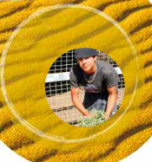
What we hope to achieve?
Contribute to an increase in school attendance and retention
Increase student transitions from school to employment or tertiary education
Increase the number of Aboriginal people employed
Increase the number of Aboriginal owned businesses.

Slide 16
5.2 Language
and
Culture

Slide 17
What the evidence is telling us
The UNESCO Endangered Languages Atlas and the National Indigenous Language Survey have identified all remaining Aboriginal languages in NSW as critically endangered.
Action is urgent as most remaining speakers are Elders and there is little or no transmission of Aboriginal languages to younger generations
A tangible connection between language learning and psychological wellbeing, increased self esteem, reduction in youth suicide and self harm and improved physical health has been shown.
Where cultural perspectives are incorporated into the school curriculum, Indigenous students’ performances have been found to be better.

Slide 18
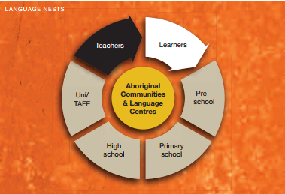
What are we doing?
Aboriginal Language and Culture Nests be trialled initially in one location each from five language groups.
Partnership with AECG, Centre for Aboriginal Languages Coordination and Development and DEC
A community based approach
Language nests in Schools

Slide 19
What we hope to achieve?
Improve knowledge of and competency in, local Aboriginal languages.
Strengthen Aboriginal identity, pride and community resilience
Increase the number of language learners
Increase the number of language teachers
Contribute to increased school attendance and retention.

Slide 20
5.3 Local Decision Making

Slide 21
What the evidence is telling us
Audit of Two Ways Together the NSW Auditor-General noted that Aboriginal communities were best placed to make decisions about their day-to-day lives and recommended continued support for community governance bodies.
The NSW government is committed to:
Systematically monitoring and evaluating service delivery outcomes within communities
Ensuring the community is well informed about what is working and what is not
Greater flexibility in spending, balanced by accountability for outcomes.

Slide 22
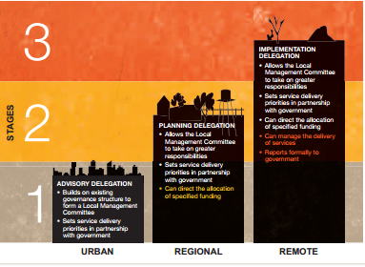
What are we doing?
A staged process of power-sharing
A commitment to building community leadership, skills and capacity.
Working with Aboriginal NGOs

Slide 23
What we hope to achieve?
Decrease in duplication of services
Increase the effectiveness of service delivery to better meet local needs
Increase the skill and capacity of local governance bodies

Slide 24
5.4 Accountability

Slide 25
What the evidence is telling us
Effective oversight of Government provides an important mechanism to drive change across the state and sends a strong signal to Aboriginal communities about the commitment to real reform and focusing effort on what works.

Slide 26
What the Community told us
Strong Aboriginal voice in design and delivery
Refocusing the role of Aboriginal Affairs
Improved coordination and Oversight
Meaningful and measurable reporting and evaluation

Slide 27
What we hope to achieve?
Embed a new partnership with Aboriginal people across Government
Ensure that all the initiatives in OCHRE are implemented successfully
Improve the effectiveness of government expenditure in Aboriginal affairs.

Slide 28
