Slide 1
GREAT
TEACHERS & SCHOOL LEADERS
26
MARCH
Rural &
Raising
Effective partnerships
Remote
Expectations
& connections
Curriculum
access for all
QUALITY
LEARNING FOR EVERY COMMUNITY
Evidence
of what works

Slide 2
Understanding rurality & remoteness
26
MARCH
Write:
2 things you know about Rural and Remote
1 question you have about Rural and Remote
Randomly (and gently) transport it to its destination – via paper plane or snowball (only one per customer!).

Slide 3
Understanding rurality & remoteness
26
MARCH
What is rural and remote?
DEC use a number of different indices and definitions:
Broadly speaking – not metropolitan (Sydney, Newcastle, Wollongong)

Slide 4
Understanding rurality & remoteness
26
MARCH
What is rural and remote?
Indices include:
Accessibility remoteness index Australia (ARIA)
MCEETYA index

Slide 5
Understanding rurality & remoteness
26
MARCH
The Accessibility Remoteness Index of
Australia (ARIA) gives locations accessibility/ remoteness values between 0 and 15.3 based on the physical road distance to the nearest town or service centre. The higher the value is, the more remote and inaccessible the location.

Slide 6
Understanding rurality & remoteness
26
MARCH
ARIA has 6 different break points:
Very remote
Remote
Outer regional
Regional
Inner regional
Major cities

Slide 7
Understanding rurality & remoteness
26
MARCH

Slide 8
Understanding rurality & remoteness
26
MARCH
MCEETYA
The Ministerial Committee on Employment, Education and Youth Affairs (MCEETYA) agreed in July 2001 to adopt the MCEETYA Schools Geographic Location Classification (MSGLC) for reporting nationally comparable schooling outcomes.

Slide 9
Understanding rurality & remoteness
26
MARCH

Slide 10
Understanding rurality & remoteness
26
MARCH
MYCEETA break points
Metropolitan
Provincial zone
Remote
Tweed fits into 1.2, along with Newcastle, Townsville, Gold Coast, Cairns, Wollongong, Queanbeyan

Slide 11
Understanding rurality & remoteness
26
MARCH
There is a sizeable ‘remoteness gap’ in student outcomes

Slide 12
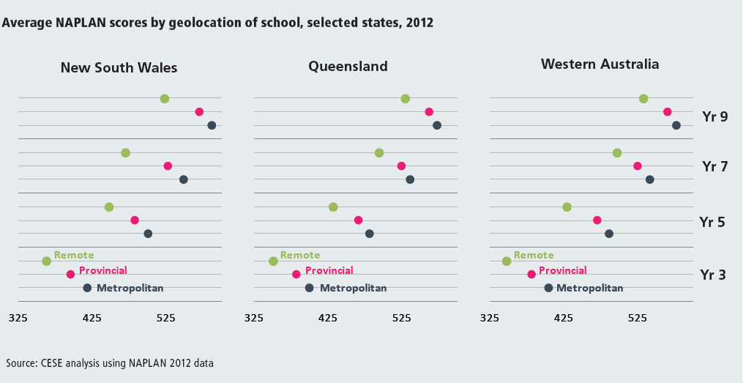
Understanding rurality & remoteness
26
MARCH

Slide 13
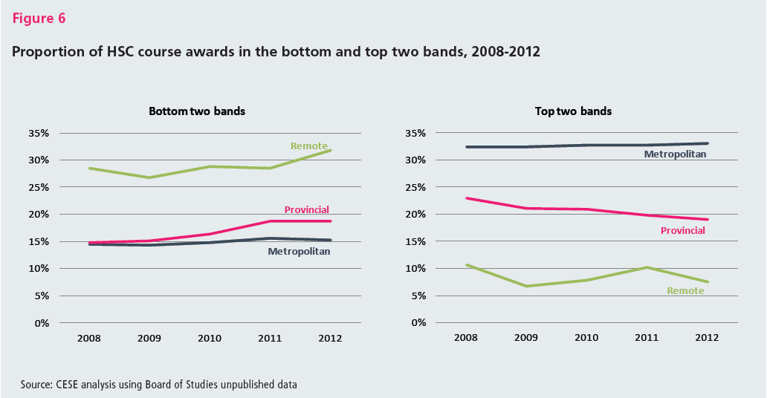
Understanding rurality & remoteness
26
MARCH

Slide 14
Understanding rurality & remoteness
26
MARCH

Slide 15
Understanding rurality & remoteness
26
MARCH
All schools are impacted by and respond to disadvantage in their communities. In many cases, it is multiple forms of intersecting disadvantage.

Slide 16
Understanding rurality & remoteness
26
MARCH
What is different in rural and remote communities is how geographic isolation amplifies the impact of intersecting disadvantage.

Slide 17
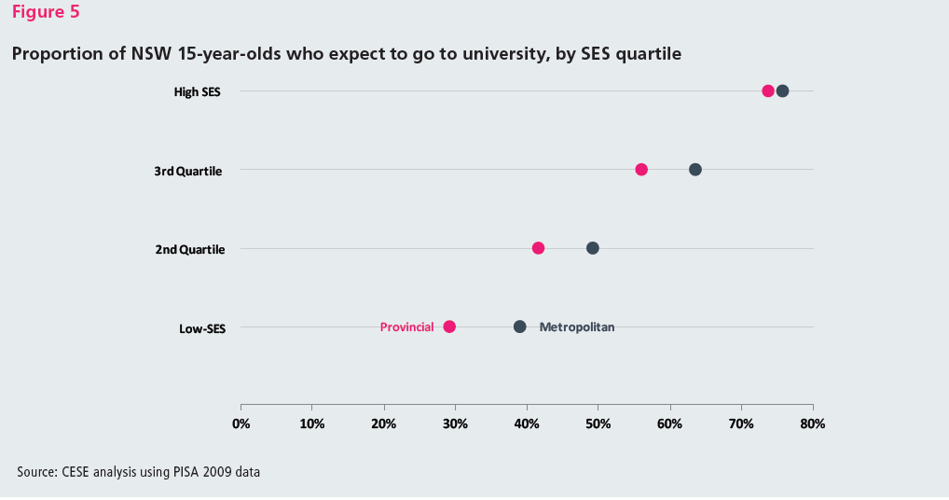
Understanding rurality & remoteness
26
MARCH

Slide 18
Understanding rurality & remoteness
26
MARCH
The NSW Department of Education and Communities is committed to equity of outcomes for students in NSW.

Slide 19
Understanding rurality & remoteness
26
MARCH
A range of programs are available for students and schools to provide access and improve learning outcomes, particularly in rural areas.

Slide 20
Notes:
Poll Title: Will all vacancies in rural and remote eight point incentive schools have a $10,000 recruitment benefit? http://www.polleverywhere.com/multiple_choice_polls/DiMLK3kalKoqdZV

Slide 21
Understanding rurality & remoteness
26
MARCH

Slide 22
Understanding rurality & remoteness
26
MARCH

Slide 23
Understanding rurality & remoteness
26
MARCH
Access to quality early childhood education.

Slide 24
Understanding rurality & remoteness
26
MARCH
Providing students with quality teaching.

Slide 25
Understanding rurality & remoteness
26
MARCH
Providing students with access to a broad and rigorous curriculum.

Slide 26
Understanding rurality & remoteness
26
MARCH
Raising student expectations and pathways into further study.

Slide 27
Blueprint
for action
26
MARCH

Slide 28
Blueprint
for action
26
MARCH
strengthen early childhood education for children in rural and remotes communities;

Slide 29
Blueprint
for action
26
MARCH
give students in rural and remote schools access to a broad range of curriculum opportunities;

Slide 30
Blueprint
for action
26
MARCH
provide new incentives to attract and retain quality teachers and school leaders to rural and remote schools;

Slide 31
Blueprint
for action
26
MARCH
better support schools to meet student needs by establishing 15 specialist centres to coordinate inter-agency health and wellbeing services

Slide 32
Blueprint
for action
26
MARCH

Slide 33
Effective Partnerships
and Connections
26
MARCH
Current state | Future State
Access to allied health services in rural and remote communities may be limited or non-existent. | Specialist centres coordinate and provide rural and remote schools with access to the expertise and assistance they require from allied health services.
School staff and leaders have varying skills and expertise in facilitating support for students with additional learning needs. | Teachers and school leaders have access to professional learning and expert advice so they can meet the learning and support needs of every student.
Current State Future State

Slide 34
Effective Partnerships
and Connections
26
MARCH
SPECIALIST CENTRES
By 2017 all 15 specialist centres will be operating in rural and remote NSW to provide expert and coordinated advice and support services to schools.

Slide 35
Effective Partnerships
and Connections
26
MARCH
SPECIALIST CENTRES
The Department’s network of specialist centres will assist schools as they identify and put in place the critical “wrap around” support for children and young people they determine to be most at risk. This will be done by using departmental expertise and directly linking schools and families with government and non-government specialist services across health and community services.

Slide 36
Effective Partnerships
and Connections
26
MARCH
Current state | Future State
State boundaries can limit teachers’ opportunities to work with nearby colleagues and build professional networks. | Teachers are able to work across borders to access professional networks and expertise.
Some students and families travel long distances to access services in their own state when the closest service is available in the neighbouring state or territory. | Students and their families have access to cross border facilities and services.

Slide 37
Effective Partnerships
and Connections
26
MARCH

Slide 38
Effective Partnerships
and Connections
26
MARCH

Slide 39
Effective Partnerships
and Connections
26
MARCH

Slide 40
Effective Partnerships
and Connections
26
MARCH
[Border}

Slide 41
What are
TeachMeets?
26
MARCH
TeachMeets are meetings/un-conferences where teachers share good practice, practical ideas and personal insights into teaching with technology.
All participants are encouraged to be ready to volunteer an idea, a tool or a website that they have delivered in their classroom.

Slide 42
What are
TeachMeets?
26
MARCH
Any teacher can host a TeachMeet, and choose a theme relevant to their practice – participants then offer to present an idea that is related to the theme
Many spaces can hold a TeachMeet – pubs, libraries, schools!
Alternatively they can discuss a product that they believe enhances their classroom practice.
New scheme teachers are encouraged to attend and learn.

Slide 43
What are
TeachMeets?
26
MARCH
The idea behind TeachMeets is hearing stories about learning, from teachers (and sometimes students as well!)
This is a chance for teachers from all types of schools to network and to hear ideas from each other.
A key element of a good TeachMeet is offering a variety of short, sharp presentations rather than longwinded keynotes.
TeachMeets are open to all regardless of experience, qualifications or sector and do not charge an entry fee

Slide 44
What are
TeachMeets?
26
MARCH
to be held @ Banora Point High School Library on
April @ 5.30pm, followed by dinner.
Invitations to be sent to Secondary and Primary Schools in Tweed and Gold Coast
PROPOSAL:
1st BORDER TEACHMEET

Slide 45
Curriculum
access for all
26
MARCH
Current state | Future State
Some rural and remote schools, especially small ones, face difficulty in offering students a broad curriculum. | A new virtual secondary school allows students to study specialist subjects they cannot access in their own school.
Academically gifted students in rural and remote schools are not always able to access the specialist curriculum they require. | Gifted and talented secondary students access extension courses and selective classes through a virtual school.
2015 - The first students enrol in the new virtual secondary school.

Slide 46
Great teachers and
school leaders
26
MARCH
Current state | Future State
Teachers are not sure that a move to a rural and remote location will work for them. | 10 week trial before their permanent appointment is confirmed.
Rural and remote schools find it difficult to attract and retain teachers and leaders. | A new range of incentives to attract and retain more of the best teachers and leaders.
Teachers and leaders in rural and remote schools have limited experience with NAPLAN and HSC marking. | Teachers and leaders have increased opportunities to experience real or simulated NAPLAN and HSC marking.
2014 – First year permanent teachers provided with 2 hours release time and 1 hour mentoring.

Slide 47
Quality learning for
every community
26
MARCH
Current state | Future State
Funding to schools has not been transparent, nor responsive to changing school and student needs. | Rural and remote schools receive increased funding delivered through Resource Allocation Model (RAM).
Schools in some communities work in isolation from other schools. | Rural and remote schools are supported to establish education networks that bring together resources across a number of schools to meet local needs.
The Department’s state-wide ‘one size fits all’ approach to all policies restricts locally developed solutions. | Principals are given more authority under Local Schools, Local Decisions.
2016 – All schools receive their full budget allocation through the RAM.

Slide 48
Blueprint
for action
26
MARCH

Slide 49
FAQs
26
MARCH
What is an education network?
An education network is a group of schools working together and jointly sharing and managing their resources to deliver quality learning to their students. These networks will be designed by local school communities to meet their specific needs and need not be limited by geographical boundaries. The decision to form a network will be made by school principals and their local communities, in consultation with Directors Public Schools NSW and the Directors Educational Services.

Slide 50
FAQs
26
MARCH
How will the networks’ staffing and budgeting be managed?
Each network will meet the unique educational needs of their community. Decisions about where teachers are located, whether teaching will be face-to-face or online, and where executive members of staff will be placed will be made by school principals in consultation with their local communities. Class sizes will be maintained in accordance with the staffing agreement, and the total staffing of the network will be determined by student numbers for each of the schools in the network, as is the case with all schools across NSW. Networks will have a management agreement that summarises how resources will be shared, where teachers and school executive are located and how decisions are made.

Slide 51
FAQs
26
MARCH
Who will decide on the focus of each network and the schools involved?
School principals and their local communities will have the opportunity to work closely with their Directors Public Schools NSW and the Directors Educational Services to establish each education network. School principals, in collaboration with their school communities, will make decisions about the focus of their network.

Slide 52
FAQs
26
MARCH
What is an Educational Service Team and how will they work?
An Educational Services team is made up of expert, non school-based staff with recent school-based experience to provide direct support and services to schools and education networks. Each Educational Services team is led by a Director Educational Services. These teams have been created as part of the new model of support to NSW public schools.

Slide 53
FAQs
26
MARCH
What is an Educational Service Team and how will they work?
Educational Services teams will provide professional learning, expert advice and support to schools in areas such as: quality teaching and professional practice; pathways for senior students; vocational education and training (VET); students with additional needs; learning and support; student engagement and wellbeing; and Aboriginal education..

Slide 54
FAQs
26
MARCH
What is an Educational Service Team and how will they work?
These teams will also be able to draw on the expertise of state office staff and coordinate work with other government and non-government organisations.

Slide 55
FAQs
26
MARCH
What services will specialist centres provide?
The specific needs of each local school community will determine the types of support and services each specialist centre will provide. Some communities may need expert support and advice about effective transition to school. Other communities may need their specialist centre to coordinate staff whose area of expertise is working with students with mental health, wellbeing or engagement issues. The network of specialist centres will draw on the expertise of Departmental staff, other government agencies and non-government organisations. .

Slide 56
FAQs
26
MARCH
What is the virtual secondary school?
A virtual school links teachers and students in a number of different locations using technology to create enriched and engaging learning environments. This will allow students in rural and remote schools to study in their local school and also enrol in one or more specialist courses in the virtual school. Students will use a range of technologies to link them with classmates in other locations and a teacher in another school. The Department’s virtual secondary school will be based on what we have learnt from our current programs such as Access, e2 and Xsel, as well as national and international distance and rural education models.

Slide 57
FAQs
26
MARCH
What is the virtual secondary school?
Expansion of virtual selective class provision for Year 7 entry in 2015
Previously only students in rural and remote areas in Western New South Wales were eligible to participate in the virtual selective class provision. From 2014 parents from all other rural and remote areas in the State are eligible to apply for entry to the virtual selective class provision on behalf of their gifted and talented children.

Slide 58
FAQs
26
MARCH
What is the virtual secondary school?
Students successful for entry to this virtual class will be enrolled at a local government high school for the majority of their subjects but will be taught English, mathematics and science in a virtual environment together with other gifted and talented students in rural and remote areas through the creative use of communications technologies. This means that they can access a challenging academic program without leaving home and friends to do so

Slide 59
FAQs
26
MARCH
How will students for the selective classes be chosen?
The virtual secondary school will be partially selective providing curriculum extension for gifted and talented secondary students. Students will apply for selective classes using the current departmental selective schools process. Enrolment priority for stage 5 and 6 courses will be given to students in the most remote locations.

Slide 60
Related
Documents
26
MARCH
https://www.det.nsw.edu.au/media/downloads/about-us/our-reforms/rural-and-remote-education/randr-blueprint.pdf

Slide 61
Related
Documents
26
MARCH

Slide 62
Related
Documents
26
MARCH

Slide 63
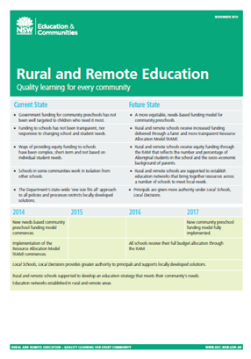
Related
Documents
26
MARCH

Slide 64
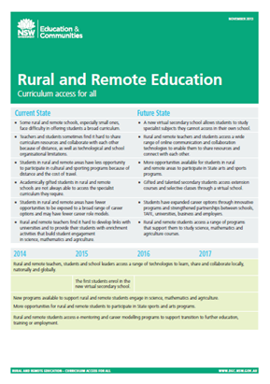
Related
Documents
26
MARCH

Slide 65
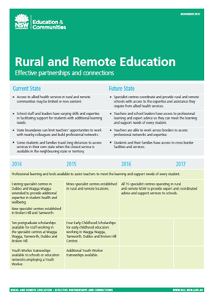
Related
Documents
26
MARCH

Slide 66
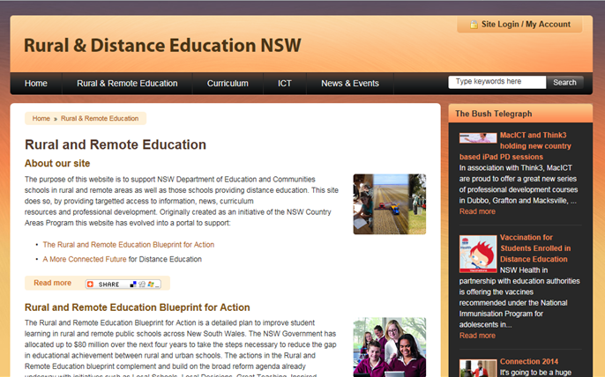
Related
Websites
26
MARCH
http://www.rde.nsw.edu.au/rural-and-remote-education

Slide 67
Useful
Links
26
MARCH
http://www.rde.nsw.edu.au/rural-and-remote-education
https://www.det.nsw.edu.au/media/downloads/about-us/our-reforms/rural-and-remote-education/randr-blueprint.pdf
http://www.dec.nsw.gov.au/about-the-department/our-reforms/rural-and-remote-education

Slide 68
Visible thinking
ROUTINES
26
MARCH

